Slide 1
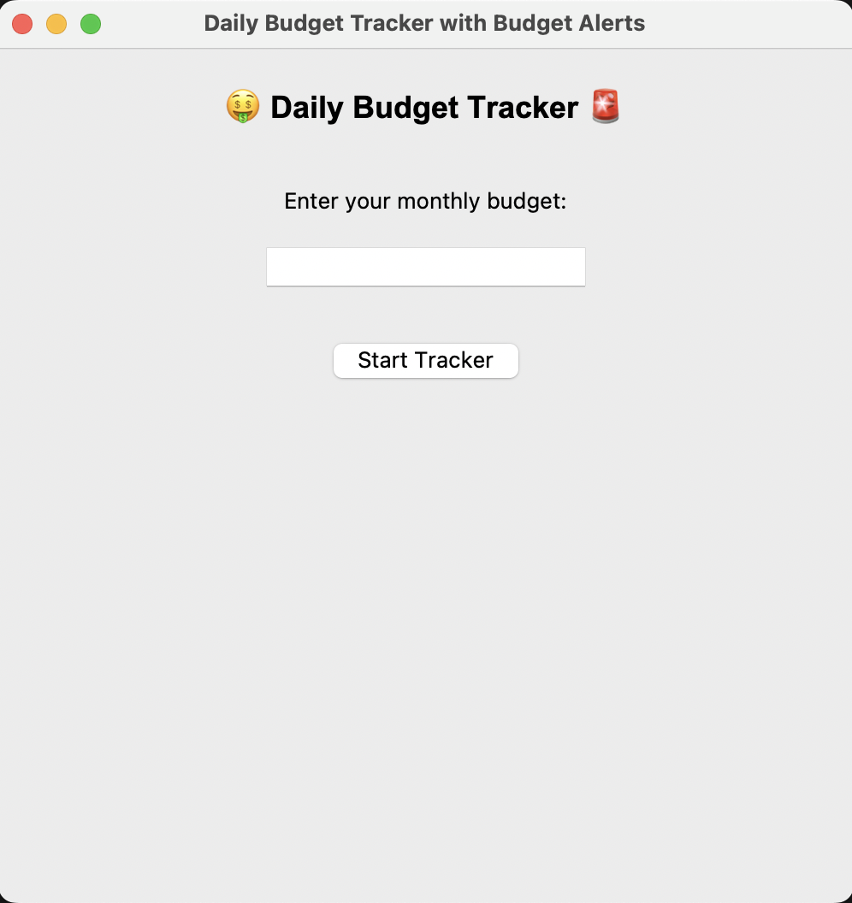
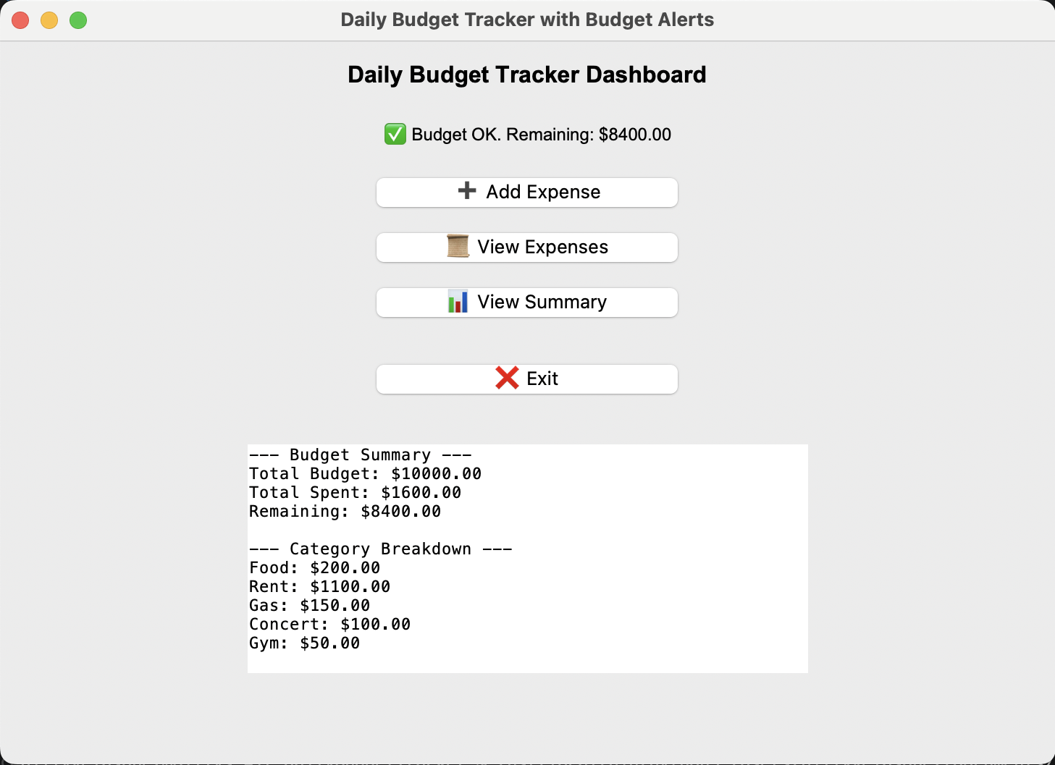
Daily budget tracker
Tracking your spending, stay on budget, and understand where your money goes
Billy Velasquez

